Slide 1

UNIVERSITY INSTITUTEOF ENGINEERING
Bachelor of Engineering (Computer Science & Engineering)
Operating System (CST-328)
Subject Coordinator: Er. Puneet kaur (E6913)
Introduction to Operating System
DISCOVER . LEARN . EMPOWER
Font size 24

Slide 2
Lecture 14 Memory Allocation Techniques Contiguous Allocation (Single Space) Partitioned Allocation (Multiple spaces) & Dynamic Storage Allocation

Slide 3
Memory Allocation
Memory allocation is a process by which computer programs are assigned memory or space.
Main memory usually has two partitions −
Low Memory − Operating system resides in this memory.
High Memory − User processes are held in high memory.
High Memory can be partitioned in following ways:
Contiguous Allocation : a) Single/Fixed-Size partition
b) Multiple/Variable-Size Partition
Dynamic Storage Allocation: a) First Fit
b) Best Fit
c) Worst Fit
Operating system maintains information about:
a) allocated partitions
b) free partitions (hole)

Slide 4
SINGLE PARTITION
ALLOCATION
Division of physical memory into fixed sized regions. (Allows addresses spaces to be distinct = one user can't muck with another user, or the system.)
The number of partitions determines the level of multiprogramming. Partition is given to a process when it's scheduled.
Protection around each partition determined by
bounds ( upper, lower )
base / limit.
These limits are set in the hardware.

Slide 5
Multiple-partition Allocation
Degree of multiprogramming is limited by number of partitions
Variable-partition sizes are kept for efficiency (sized to a given process’ needs)
Hole – block of available memory; holes of various size are scattered throughout memory
When a process arrives, it is allocated memory from a hole large enough to accommodate it
Process that exits frees its partition, adjacent free partitions are merged.

Slide 6
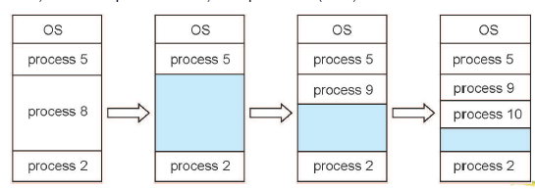
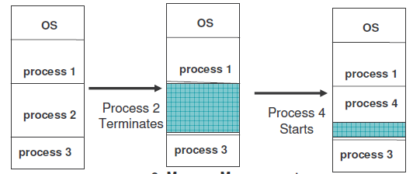
Multiple-partition Allocation
Example 1
Example 2

Slide 7
Dynamic Storage-Allocation Problem
Memory allocation is a process by which computer programs are assigned memory or space. It is of three types :
First Fit: The first hole that is big enough is allocated to program.
Best Fit: The smallest hole that is big enough is allocated to program.
must search entire list, unless ordered by size, Consumes CPU time
Worst Fit: The largest hole that is big enough is allocated to program.
must search entire list
Avoid small holes (external fragmentation). This occurs when there are many small pieces of free memory.
What should be the minimum size allocated, allocated in what chunk size?
Also avoid internal fragmentation. This is when memory is handed out in some fixed way (power of 2 for instance) and requesting program doesn't use all of it.

Slide 8
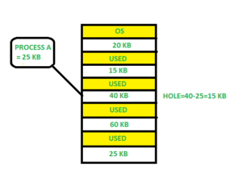
First Fit Allocation
In the first fit, the partition is allocated which is first sufficient block from the top of Main Memory. It scans memory from beginning and chooses the first available block that is large enough . Thus it allocate the first hole that is large enough.

Slide 9
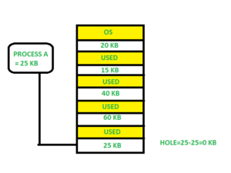
Best Fit Allocation
Allocate the process to the partition which is the first smallest sufficient partition among the free available partition. It search the entire list of holes to find the smallest hole whose size is greater than or equal to size of process.

Slide 10
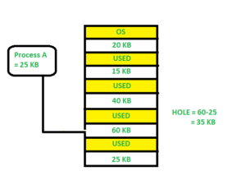
Worst Fit Allocation
Allocate the process to the partition which is the largest sufficient among the freely available partitions available in the main memory. It is opposite to the best fit algorithm. It search the entire list of hole to find the largest hole and allocate it to process.

Slide 11
Example Exercise
Que: Consider the requests from processes in given order 300K, 25K, 125K and 50K. Let there be two blocks of memory available of size 150K followed by a block size 350K. Which of the following partition allocation schemes can satisfy above requests? A) Best fit but not first fit. B) First fit but not best fit. C) Both First fit & Best fit. D) neither first fit nor best fit.

Slide 12
Solution
Best Fit: 300K is allocated from block of size 350K. 50 is left in the block. 25K is allocated from the remaining 50K block. 25K is left in the block. 125K is allocated from 150 K block. 25K is left in this block also. 50K can’t be allocated even if there is 25K + 25K space available.
First Fit: 300K request is allocated from 350K block, 50K is left out. 25K is be allocated from 150K block, 125K is left out. Then 125K and 50K are allocated to remaining left out partitions. So, first fit can handle requests.
So option B is the correct choice.

Slide 13
Conclusion
This lecture makes the student familiar with Memory allocation techniques like contiguous allocation, partitioned allocation and dynamic allocation techniques.

Slide 14
Video Link
https://www.youtube.com/watch?v=Rnfu5qyysro
https://www.youtube.com/watch?v=nUyF-S_jPgg

Slide 15
References
https://www.tutorialspoint.com/operating_system/os_memory_management.htm
https://www.studytonight.com/operating-system/memory-management
https://www.guru99.com/os-memory-management.html
https://www.geeksforgeeks.org/partition-allocation-methods-in-memory-management/
https://www.javatpoint.com/os-memory-management-introduction
http://www2.latech.edu/~box/os/ch08.pdf
https://www.cs.uic.edu/~jbell/CourseNotes/OperatingSystems/8_MainMemory.html#:~:text=8.3%20Contiguous%20Memory%20Allocation,allocated%20to%20processes%20as%20needed.
http://www.csdl.tamu.edu/~furuta/courses/99a_410/slides/chap08

